Slide 1
Data Insights on K-12

Slide 2
Members
Amartya Ayushi - 2019B2A41467H
B Shreyas Bhat - 2019B1A80969G
Vaibhav Rana - 2019A1PS1113G
Jathin Narayan - 2019A7PS1001G
Himanshu Jain - 2019A3PS0423G

Slide 3
What is Frost Insights for K-12?
Frost is a suite of integrated platforms designed to provide the digital infrastructure for your educational content. From instructional design to data to assessments, Frost can handle it all in one place, simplifying your entire content ecosystem.
Notes:
Slide - Himanshu Jain

Slide 4
The Need - Student Engagement & Risk Labelling
Student engagement plays a crucial role in education and benefits students, the college, and education partners.
It empowers students with the ability to acquire and practice the necessary skills to build a successful future. Helps in building better relationships with other students, staff, and faculty and helps the students understand governance within the institution’s education system. As a result, it improves student personality and enhances their skills that are necessary for driving change.
Notes:
Slide - Himanshu Jain ; Student engagement imparts knowledge on the true values of ownership, and develops a greater sense of responsibility while developing student communication skills and enhancing their negotiation skills.

Slide 5
Our Goal
The goal of student engagement is said to be achieved when education partners also benefit. With the implementation of student engagement plans, there will be better bonding between education partners. This provides a better understanding of student’s varying needs to boost the campus experience and promotes a more responsive education system.

Slide 6
Value Proposition
Frost Insights gives a panoramic view into each step of a student’s learning journey by leveraging rich contextual data insights, allowing teachers administrators to make the right decisions at the right time.
Notes:
Slide - Himanshu Jain

Slide 7
US Education System
Education in US is compulsory for children from 5-8 years to 16-18 years depending on the state one is living in.
87% of students, in 2013, attended state funded Public Schools.
United States spend more per student on education than any other country. US spends around 1.3 trillion(7.2% of GDP) on education(all levels).(Data from 2016-17 Budget)

Slide 8
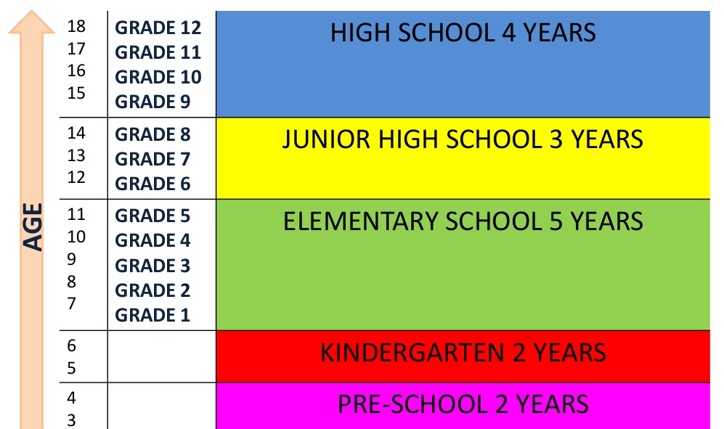

Slide 9
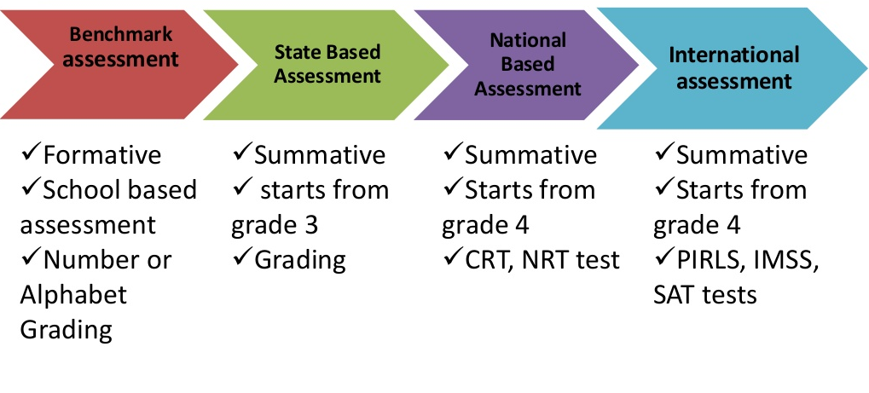
Assessment Systems

Slide 10
Standardised Test
The Standardised Tests is conducted State wise in US in order to ensure that the students are above the desired minimum level of education.
This test is only compulsory for students from Public Schools. Private Schools and Home taught students may or may not attempt this test.
Although this test was originally designed to test students intelligence and understanding capability, in recent years, the average grades of students are rising but the average SAT scores are falling.

Slide 11
Student Engagement
A meta-construct that includes behavioural, emotional, and cognitive engagement
Behavioural engagement draws on the idea of participation and includes involvement in academic, social, or extracurricular activities
Emotional engagement focuses on the extent of positive (and negative) reactions to teachers, classmates, academics, or school.
Cognitive engagement is defined as student’s level of investment in learning. It includes being thoughtful, strategic, and willing to exert the necessary effort for comprehension of complex ideas
Notes:
Behavioural
following the rules, adhering to classroom norms
Emotional
identification with the school
valuing, or an appreciation of success in school-related outcomes
Cognitive
or mastery of difficult skills

Slide 12
Reviewing methods for measuring engagement
Student Self-report: critical to collect data on students’ subjective perceptions, as opposed to just collecting objective data.
Experience Sampling: report on their thoughts, feelings, behaviors, and/or environment on multiple occasions over time, reduces problems with recall failure.

Slide 13
Teacher Ratings of Students:useful for studies with younger children who have more difficulty completing self-report instruments due to the reading demands and limited literacy skills
Interviews: can provide insight into the reasons for variability in levels of engagement in more open-ended and unstructured ways
Observations: composite of academic behaviours such as reading aloud, writing, answering questions, participating in classroom tasks, used by school psychologists to screen individual children into special need programs.

Slide 14
Engagement Algorithm
Combining faculty perception, student participation, student self perception
Engagement Index = (K1*participation_score) + (K2*faculty_assesment_score) + (K3*student_assesment_score)
Where K1 ,K2 , and K3 are weighting constants.
Normalized to keep score between 0 and 1

Slide 15
Students at risk
Students in this category are determined to be at risk of dropping out of their courses. It is crucial to have in place a dropout warning framework which would preemptively identify K-12 students who fall into this category.

Slide 16
Factors which affect dropout rates
Online vs Offline
MOOC vs interactive courses
Paid vs free content
Lack of interest/confidence
Difference in expectations of learning paths

Slide 17
Challenges
It is important to study approaches to identify at-risk K-12 online students and build an effective yet practical warning system. However, this task is rather challenging due to the following characteristics:
Multiple modalities - Difficult to determine uniform metrics due to subjective factors like quality of teachers, emotional attachment, etc.
Length variability - Should be able to differentiate students on length of learning history and whether they are newly enrolled
Data imbalance - K-12 online interactive courses have relatively low dropout rates in comparison to other forms of learning.

Slide 18
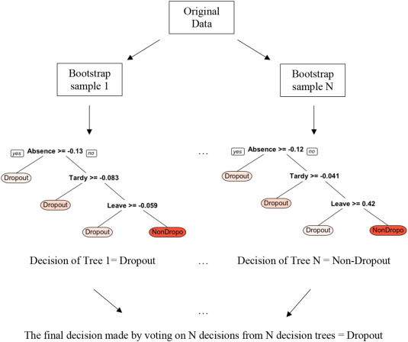
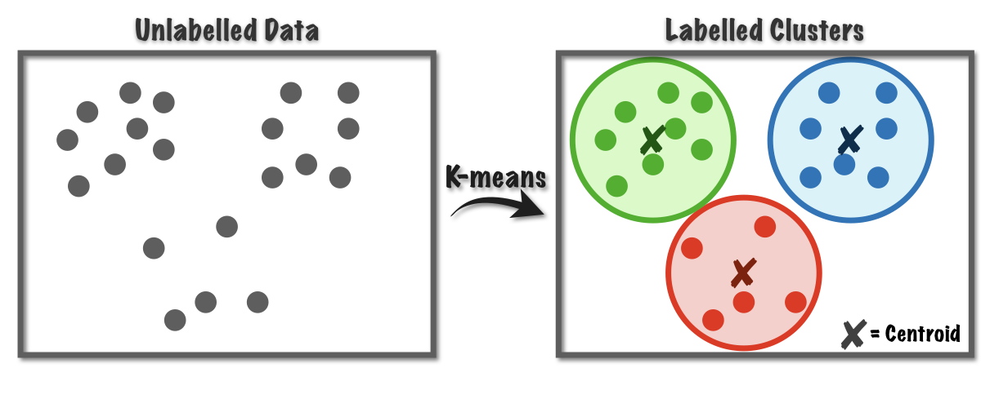
Predicting Student at Risk
Multi-class classification into ‘Low Risk’, ‘High Risk’, ‘No Risk’ of dropping out
Can be done using ‘K-Means Clustering’, ‘Decision Tree’, ‘RandomForest’, ‘Naive Bayes Classifier’ based on performance, attendance and engagement index
Defining thresholds in engagement index corresponding to the classification

Slide 19
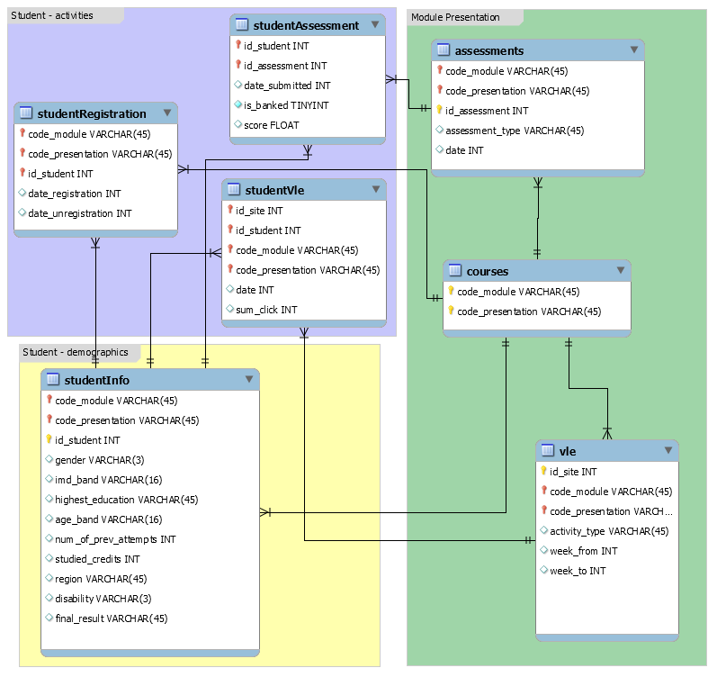
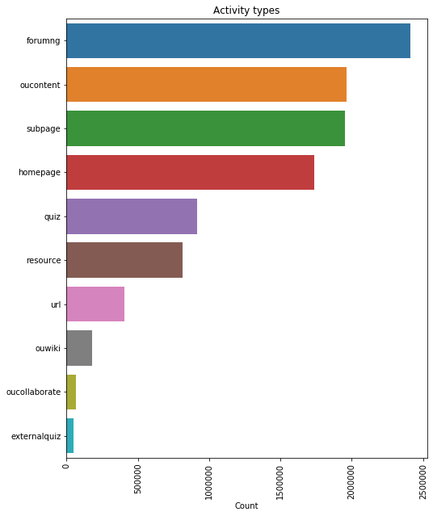
Datasets
OULAD: Open University Learning Analytics Dataset
Anonymized data about courses, students and their interactions with Virtual Learning Environment(VLE) for 7 courses

Slide 20
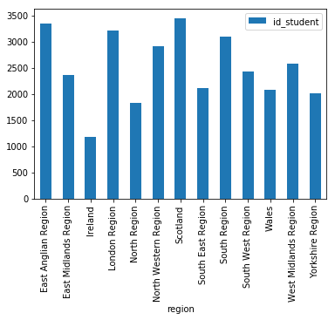
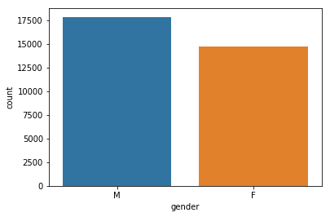
Publicly available and widely used

Slide 21
Data Anonymization
Data anonymization is the process of protecting private or sensitive information by erasing or encrypting identifiers that connect an individual to stored data.
To ensure the safety of users, we have various compliances which a company needs to follow.

Slide 22
PII ( Personally Identifiable Information )
Personally identifiable information (PII) is information that, when used alone or with other relevant data, can identify an individual. PII may contain direct identifiers (e.g., passport information) that can identify a person uniquely, or quasi-identifiers (e.g., race) that can be combined with other quasi-identifiers (e.g., date of birth) to successfully recognize an individual.

Slide 23
GDPR ( General Data Protection Regulation )
GDPR's primary aim is to give individuals control over their personal data and to simplify the regulatory environment for international business by unifying the regulation within the EU.

Slide 24
Thank You!

